Slide 1
Phonics
Junior Infants
27th April- 1st May 2020

Slide 2
Please use this PowerPoint to revise the phonics that we have covered to date, when you can.
The sounds and tricky words should be revised each day (if possible).
We have also included some blending work and reading simple sentences. These can be read multiple times to develop fluency.
There are a huge amount of slides here, but you should be able to go through them quite quickly. There is no need to spend more than 10 minutes a day on this.
Please do not feel under pressure, do what you can.

Slide 3
Sounds
Say the sound and do the action

Slide 4
n

Slide 5
c

Slide 6
l

Slide 7
ai

Slide 8
w

Slide 9
ch

Slide 10
ar

Slide 11
s

Slide 12
d

Slide 13
o

Slide 14
ee

Slide 15
oo

Slide 16
qu

Slide 17
oi

Slide 18
t

Slide 19
r

Slide 20
b

Slide 21
oa

Slide 22
v

Slide 23
y

Slide 24
ue

Slide 25
p

Slide 26
k

Slide 27
f

Slide 28
or

Slide 29
z

Slide 30
sh

Slide 31
ou

Slide 32
i

Slide 33
e

Slide 34
g

Slide 35
j

Slide 36
ng

Slide 37
th

Slide 38
er

Slide 39
a

Slide 40
h

Slide 41
u

Slide 42
ie

Slide 43
x

Slide 44
ou

Slide 45
m

Slide 46
Tricky Words
Read the tricky word

Slide 47
we

Slide 48
to

Slide 49
said

Slide 50
they

Slide 51
like

Slide 52
little

Slide 53
many

Slide 54
other

Slide 55
I

Slide 56
all

Slide 57
your

Slide 58
so

Slide 59
one

Slide 60
when

Slide 61
where

Slide 62
he

Slide 63
are

Slide 64
you

Slide 65
no

Slide 66
only

Slide 67
live

Slide 68
which

Slide 69
more

Slide 70
she

Slide 71
be

Slide 72
here

Slide 73
go

Slide 74
have

Slide 75
down

Slide 76
why

Slide 77
the

Slide 78
do

Slide 79
were

Slide 80
some

Slide 81
there

Slide 82
old

Slide 83
give

Slide 84
any

Slide 85
before

Slide 86
me

Slide 87
was

Slide 88
come

Slide 89
my

Slide 90
by

Slide 91
what

Slide 92
who

Slide 93
Blending Sounds
Sound out each of these words.

Slide 94
Monday
tin
pat
map
shed
hand
ran
camp
hen

Slide 95
Tuesday
hat
get
log
fit
duck
chip
grip
sort

Slide 96
Wednesday
puff
bat
met
hiss
test
best
pest
flap

Slide 97
Thursday
slip
flag
frog
pain
leg
mud
bit
fan

Slide 98
Friday
torch
ring
keep
road
fuss
loud
bee
zoo

Slide 99
Reading Sentences
All of the sentences are made up of regular words for the children to blend, except for the tricky words.
The tricky words are in bold.
Ask the children to find the tricky words in the sentence before reading it and remind them that we will not be sounding out these words.
The more familiar your child is with the tricky words, the more fluent their reading will become.
Practise these sentences everyday (if possible), by the end of the week the children will become more confident in reading them.

Slide 100
The sun is hot.

Slide 101
I sleep in a bed.

Slide 102
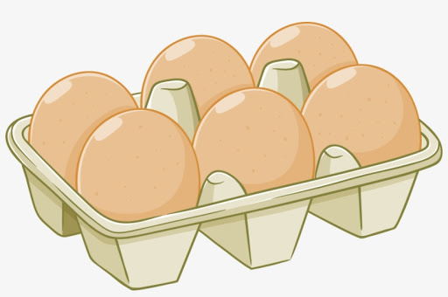
We had eggs for dinner.

Slide 103
I go up the steps.

Slide 104
She was six in March.

Slide 105
The sun is hot.
I sleep in a bed.
We had eggs for dinner.
I go up the steps.
She was six in March.

Slide 106
Word Games
This activity can be done orally or the children can write down the missing sound on a piece of paper. Say the word and clap out the sounds.

Slide 107
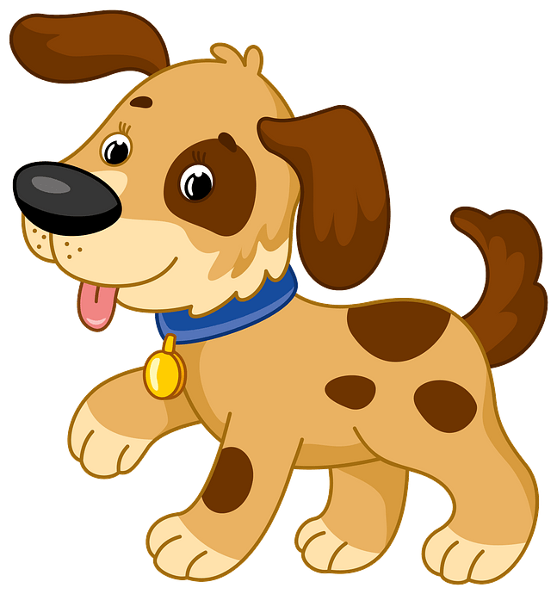
Can you find the missing sound?
d __ g

Slide 108
Can you find the missing sound?
n __ t

Slide 109
Can you find the missing sound?
m __ g

Slide 110
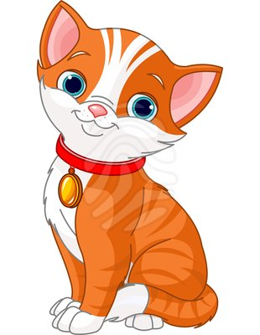
Can you find the missing sound?
c _ t

Slide 111
Play ‘I Spy’

