Slide 1
Phonics
Senior Infants
Revision Week
06/05/20 – 08/05/20

Slide 2
Please use this PowerPoint to revise the phonics that we have covered to date, when you can.
The sounds, tricky words and alternatives should be revised each day (if possible).
There are five slides for blending. Your child should sound out each word.
There are some word games at the end.
Please continue to work on the dictation homework and the list of dictation phrases that were in the Word document that we uploaded to the school website when we finished up in school.
There is no need to spend more than 10-15 minutes a day on this.
Please do not feel under pressure, do what you can.

Slide 3
Sounds
Say the sound

Slide 4
n

Slide 5
c

Slide 6
l

Slide 7
ai

Slide 8
w

Slide 9
ch

Slide 10
ar

Slide 11
s

Slide 12
d

Slide 13
o

Slide 14
ee

Slide 15
oo

Slide 16
qu

Slide 17
oi

Slide 18
t

Slide 19
r

Slide 20
b

Slide 21
oa

Slide 22
v

Slide 23
y

Slide 24
ue

Slide 25
p

Slide 26
k

Slide 27
f

Slide 28
or

Slide 29
z

Slide 30
sh

Slide 31
ou

Slide 32
i

Slide 33
e

Slide 34
g

Slide 35
j

Slide 36
ng

Slide 37
th

Slide 38
er

Slide 39
a

Slide 40
h

Slide 41
u

Slide 42
ie

Slide 43
x

Slide 44
ou

Slide 45
m

Slide 46
Tricky Words
Read the tricky word

Slide 47
we

Slide 48
to

Slide 49
said

Slide 50
they

Slide 51
like

Slide 52
little

Slide 53
many

Slide 54
other

Slide 55
saw

Slide 56
their

Slide 57
upon

Slide 58
every

Slide 59
I

Slide 60
all

Slide 61
your

Slide 62
so

Slide 63
one

Slide 64
when

Slide 65
where

Slide 66
want

Slide 67
could

Slide 68
does

Slide 69
of

Slide 70
cover

Slide 71
he

Slide 72
are

Slide 73
you

Slide 74
no

Slide 75
only

Slide 76
live

Slide 77
which

Slide 78
more

Slide 79
would

Slide 80
four

Slide 81
also

Slide 82
father

Slide 83
she

Slide 84
be

Slide 85
here

Slide 86
go

Slide 87
have

Slide 88
down

Slide 89
why

Slide 90
because

Slide 91
put

Slide 92
two

Slide 93
always

Slide 94
love

Slide 95
the

Slide 96
do

Slide 97
some

Slide 98
there

Slide 99
old

Slide 100
give

Slide 101
any

Slide 102
before

Slide 103
should

Slide 104
made

Slide 105
eight

Slide 106
after

Slide 107
me

Slide 108
was

Slide 109
come

Slide 110
my

Slide 111
by

Slide 112
what

Slide 113
who

Slide 114
were

Slide 115
right

Slide 116
goes

Slide 117
once

Slide 118
mother

Slide 119
Alternatives
Say the sound

Slide 120
ue

Slide 121
er

Slide 122
ge

Slide 123
ea

Slide 124
ou

Slide 125
gi

Slide 126
ow

Slide 127
ie

Slide 128
ew

Slide 129
gy

Slide 130
ay

Slide 131
i_e

Slide 132
oa

Slide 133
oi

Slide 134
ee

Slide 135
y

Slide 136
ir

Slide 137
oy

Slide 138
ai

Slide 139
ur

Slide 140
o_e

Slide 141
ck

Slide 142
e_e

Slide 143
igh

Slide 144
a_e

Slide 145
u_e

Slide 146
Blending
Sound out these words

Slide 147
Wednesday
led
pill
rain
frill
lamp
Curve
Strip
stretch
target
carthorse

Slide 148
Thursday
zap
lock
join
wood
rest
burning
drifting
grumble
sprinter
roundabout

Slide 149
Friday
tub
hiss
boot
hang
loft
perfect
thirsty
swirl
mixing
Saturday

Slide 150
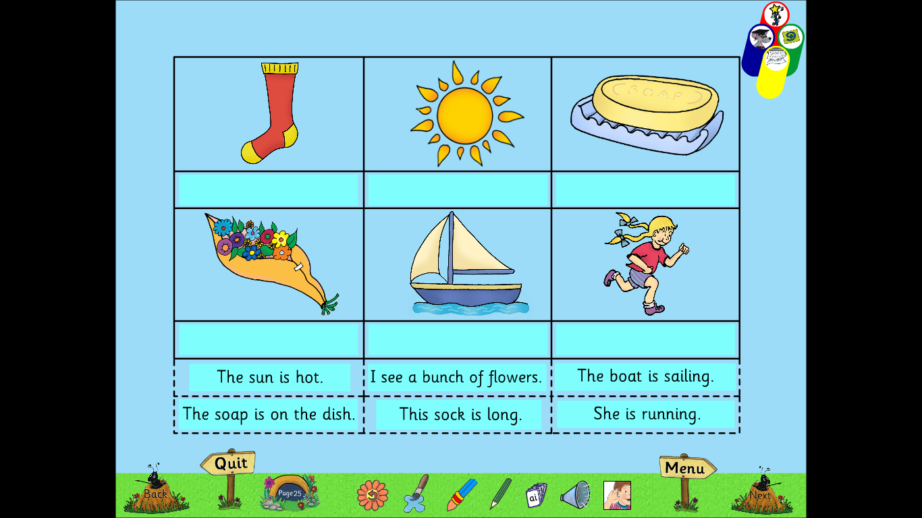
Read each sentence. Match the sentence to the correct picture

