Slide 1
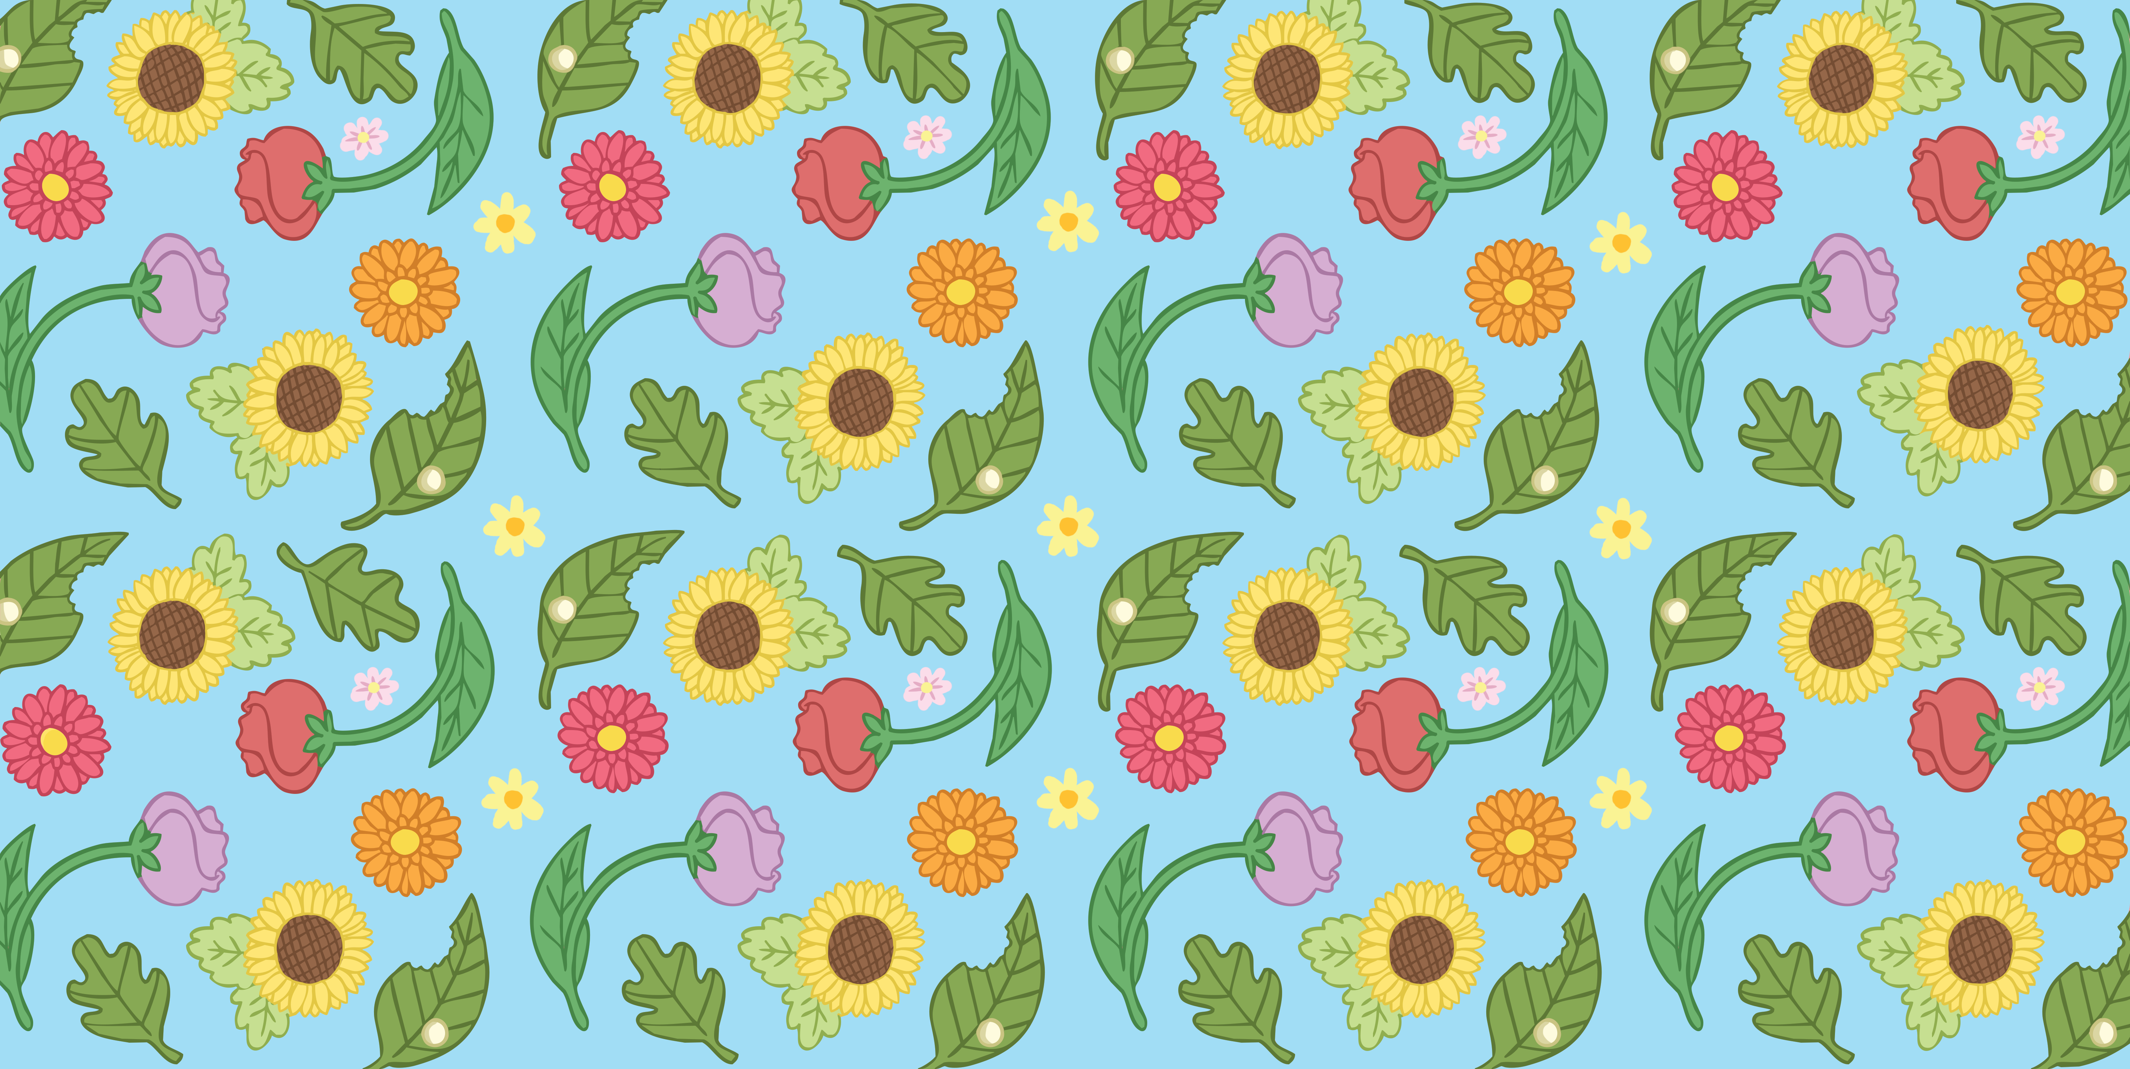


Slide 2
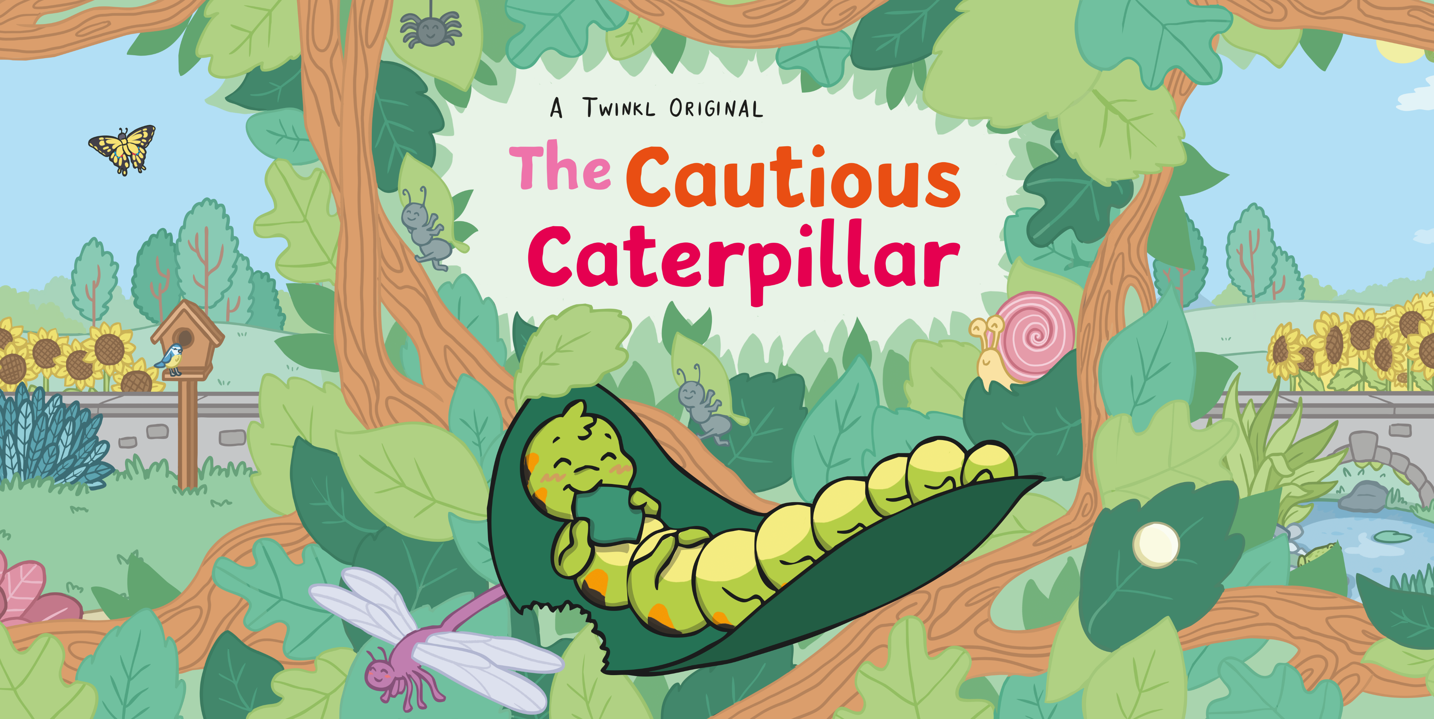

Slide 3
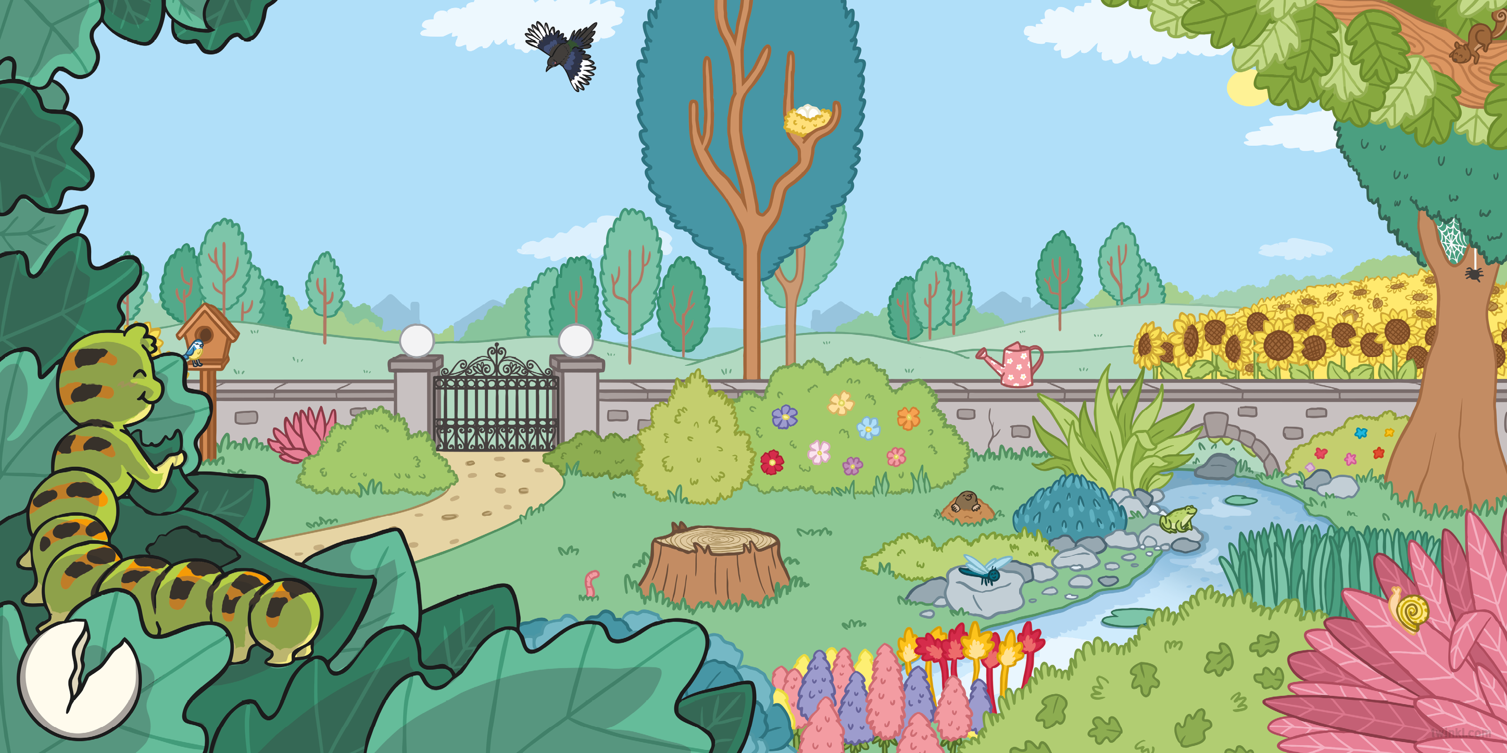
It was springtime in the garden.
Cody the Caterpillar hatched from her egg and crawled onto a big green leaf.
She smiled happily.
“I love being a caterpillar!” she said and began to eat her tasty leaf.

Slide 4
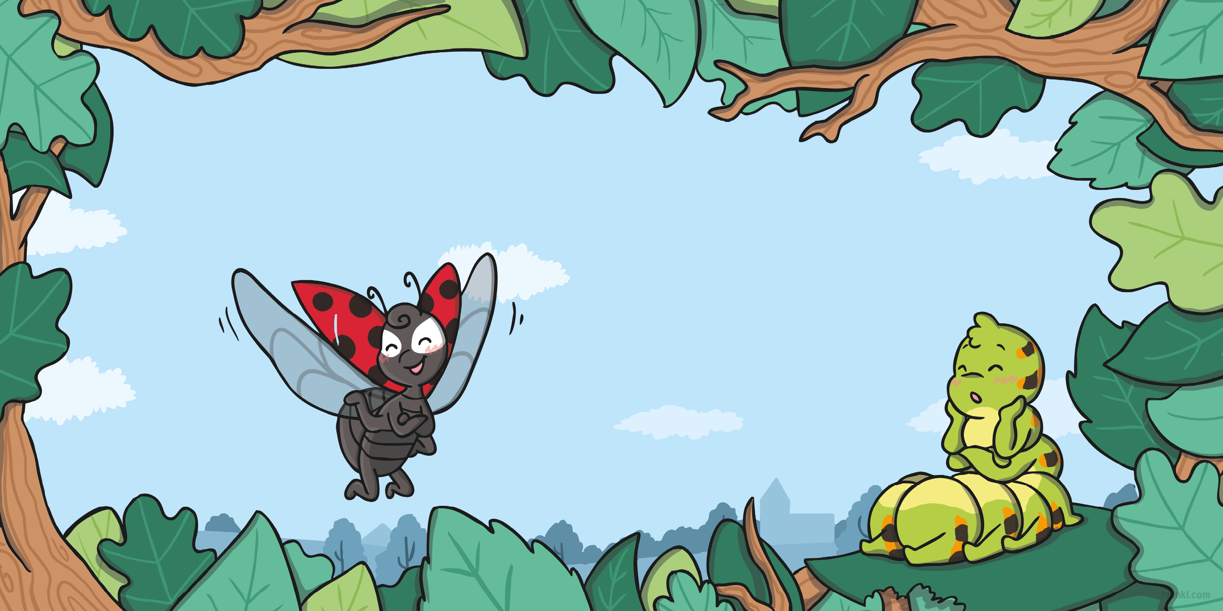
Just then, a ladybird flew on over.
“You’re very lucky!” said the ladybird. “When you become a butterfly, you will have wings, like me!”
“Flying looks very tiring,” said Cody. “I wish I could stay as a
caterpillar forever!”

Slide 5
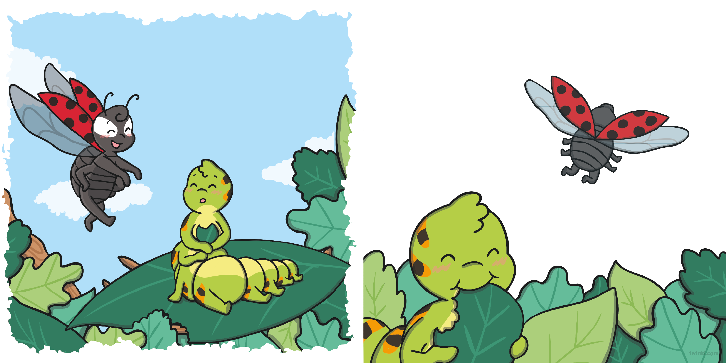
Cody smiled but didn’t feel sure. “Maybe one day,” she said.
“Don’t worry,” said the ladybird, “having wings is great. You can always stop for a rest!”
She carried on eating and the ladybird flew away.

Slide 6
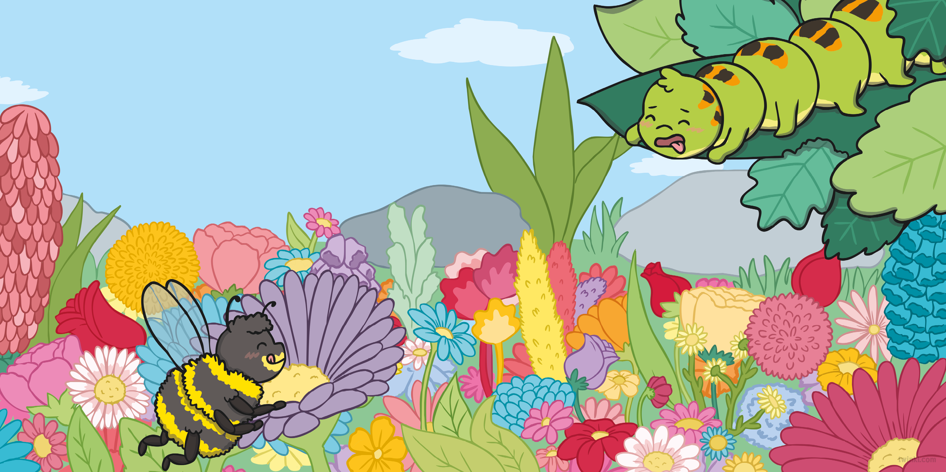
The next day, a bee buzzed on over.
“You’re very lucky!” said the bee. “When you become a butterfly, you will sip nectar like me!”
“I don’t think I will like nectar,” said Cody. “I wish I could stay as a caterpillar forever!”

Slide 7
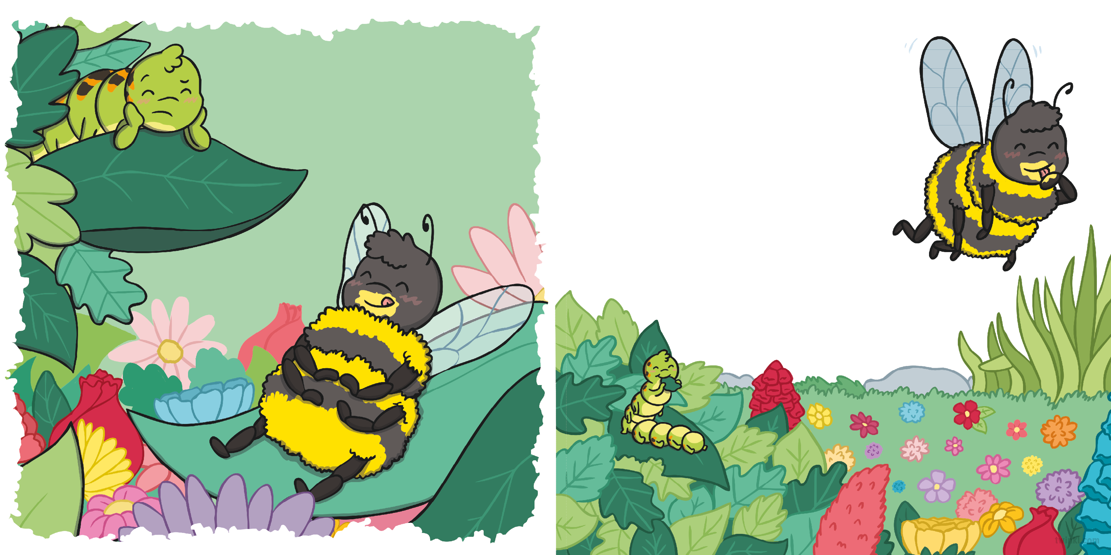
“Don’t worry,” said the bee, “drinking nectar is great. It is ever so yummy!”
Cody smiled but didn’t feel sure. “Maybe one day,” she said.
She carried on eating and the bee buzzed away.

Slide 8
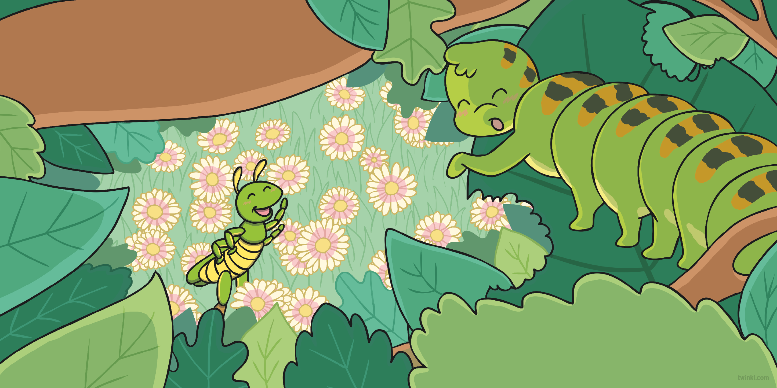
A few days later, a grasshopper jumped on over.
“You’re very lucky!” said the grasshopper.
“When you become a butterfly, you will
have six legs, like me!”
“But I like having sixteen legs,” said Cody.
“I wish I could stay as a caterpillar forever!”

Slide 9
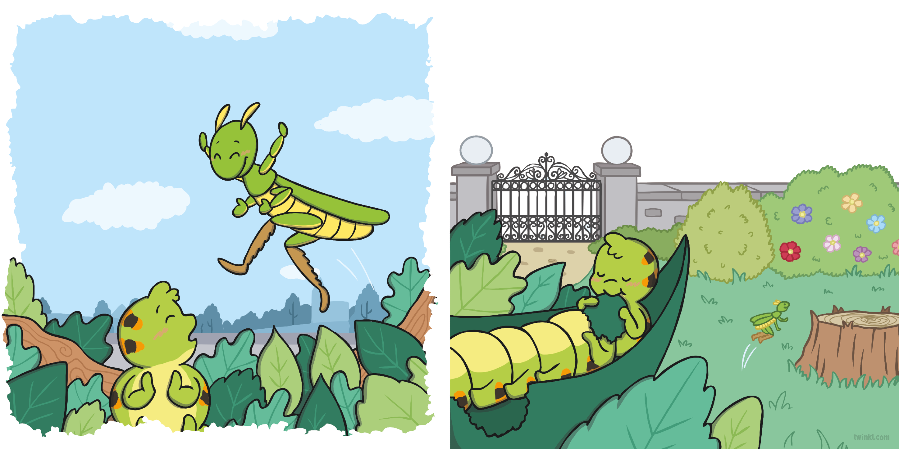
“Don’t worry,” said the grasshopper, “having six legs is great. That’s plenty for landing on the ground!”
Cody smiled but didn’t feel sure. “Maybe one day,” she said.
She carried on eating and the grasshopper jumped away.

Slide 10
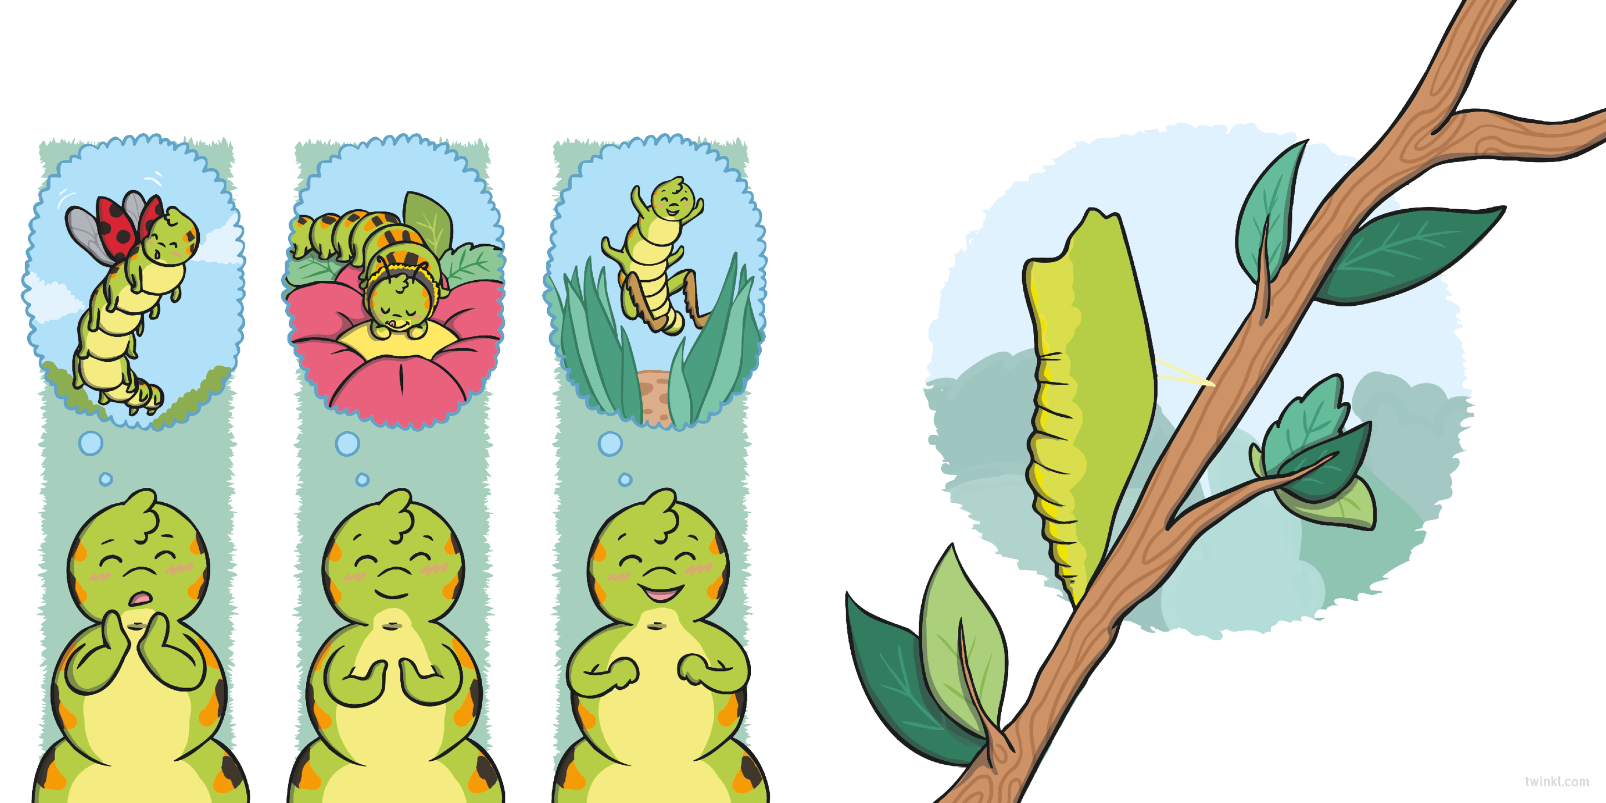
The next day, Cody was full. She thought about everything her friends had told her and decided to be brave.
Maybe today!” she said, as she changed herself into a chrysalis.
She stayed like that for many days, until she was finally ready to leave her chrysalis...

Slide 11
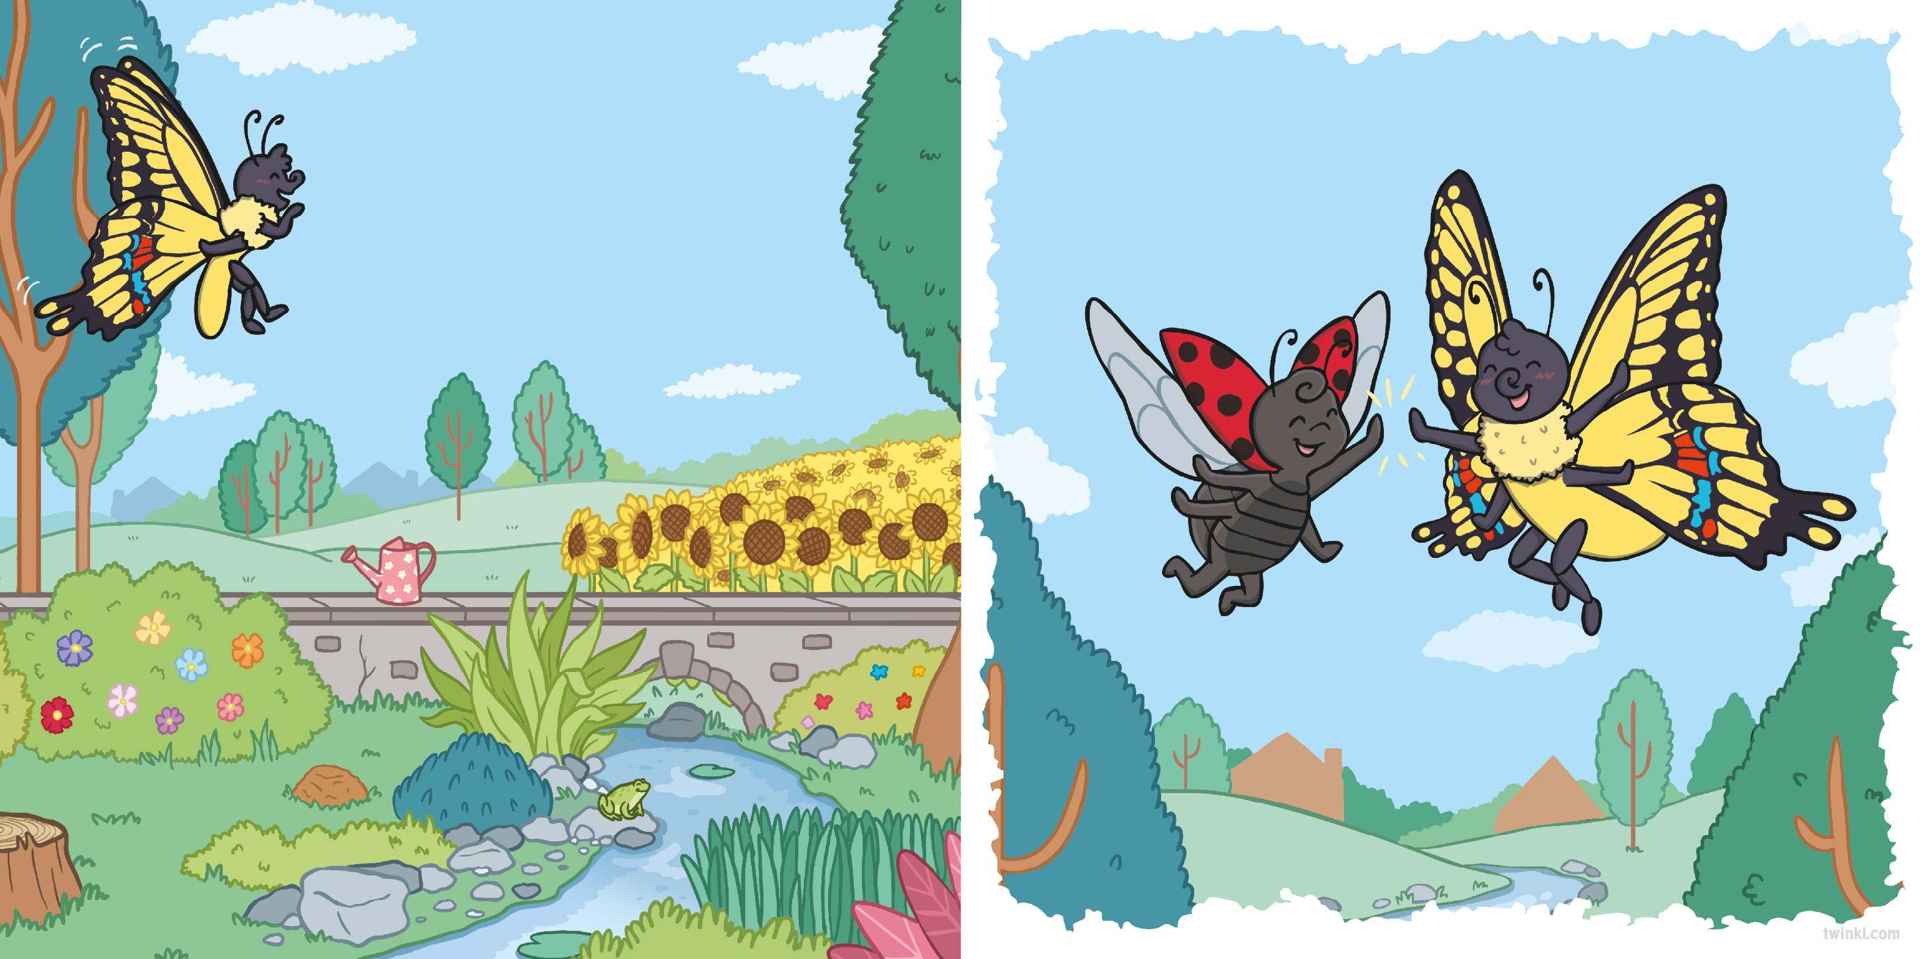
...and become a butterfly!
Cody explored the garden, feeling happy and proud of her new wings.
“Having wings is great!” she said, as she flew past the ladybird.

Slide 12
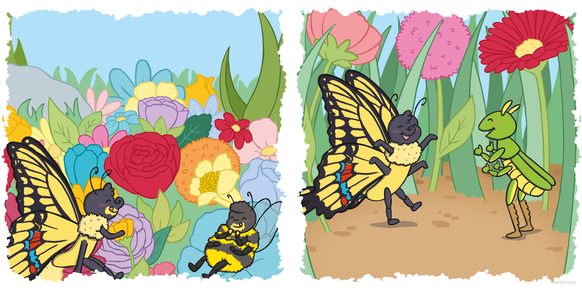
“This is yummy!” she said to the bee, as they sipped nectar together.
“Six legs is plenty!” said Cody, as she landed next to the grasshopper.

Slide 13
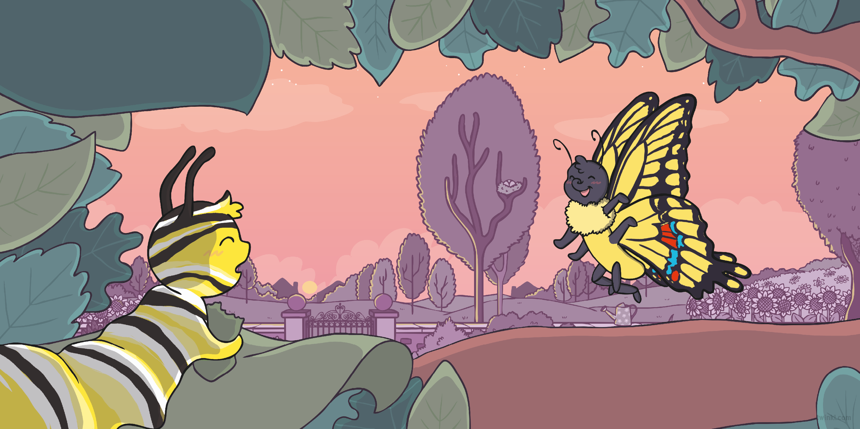
That evening, she came across a caterpillar eating a tasty green leaf.
“You’re very lucky!” said Cody. “When you have finished eating, you will become a butterfly, like me!”

Slide 14
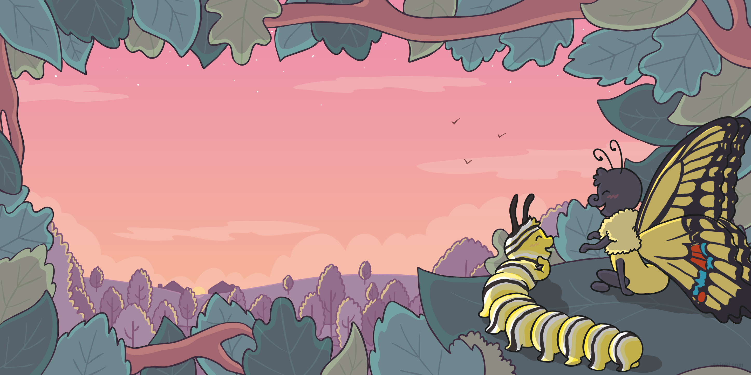
The caterpillar smiled but didn’t look sure.
“I wish I could stay as a caterpillar forever!” he said.
“Don’t worry,” said Cody. “I loved being a caterpillar too, but trust me, being a butterfly is great!”

Slide 16
